Slide 1

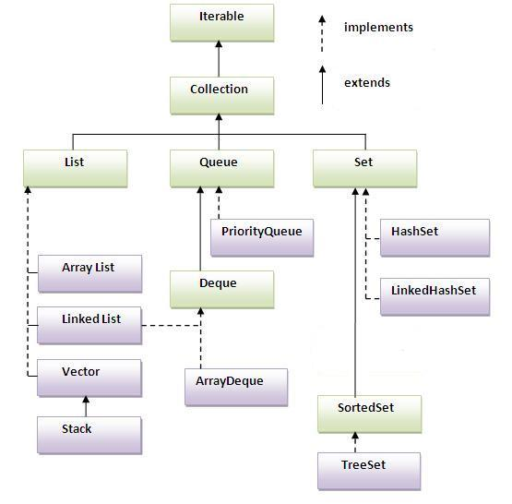
Hierarchy of Collection

Slide 2
Hierarchy of Collection
Collections can be

